Slide 1
SEND Information Report Overview
2018-2019

Slide 3
At St Joseph’s, for those children identified by the class teacher as requiring additional support, the teacher will complete an initial concerns form.
The form allows the teacher to reflect on the support the child has already received through ‘First Quality Teaching’, Interventions or use of other resources.
This is identified as ‘Wave One” provision. Once parental views and, where appropriate the child’s view have been sought, Mrs McDonagh will, after consultation with all parties, place the child on the SEN Support register. This will provide additional support through ‘Wave Two and Wave Three provision

Slide 4
Wave 3
Outside agencies:
Educational Psychologist
School’s allocated Speech and Language therapist
CCN/Autism Specialists
Occupational Therapists
Wave 2
Additional or different support in school.
Intervention Programmes
Wave 1
Quality First Teaching
Monitored –Initial Concern Forms

Slide 5
Four Areas of Need
Areas of Need
Communication and Interaction
Cognition and Learning
Social, Emotional or Mental Health
Sensory and or Physical

Slide 6
Communication & Interaction
Children and young people with speech, language and communication needs (SLCN) have difficulty in communicating with others. This may be because they have difficulty saying what they want to, understanding what is being said to them or they do not understand or use social rules of communication. The profile for every child with SLCN is different and their needs may change over time. They may have difficulty with one, some or all of the different aspects of speech, language or social communication at different times of their lives.
Children and young people with ASD, including Asperger’s Syndrome and Autism, are likely to have particular difficulties with social interaction. They may also experience difficulties with language, communication and imagination, which can impact on how they relate to others.

Slide 7
Cognition and Learning
Support for learning difficulties may be required when children and young people learn at a slower pace than their peers, even with appropriate differentiation. Learning difficulties cover a wide range of needs, including moderate learning difficulties (MLD), severe learning difficulties (SLD), where children are likely to need support in all areas of the curriculum and associated difficulties with mobility and communication, through to profound and multiple learning difficulties (PMLD), where children are likely to have severe and complex learning difficulties as well as a physical disability or sensory impairment.
Specific learning difficulties (SpLD), affect one or more specific aspects of learning. This encompasses a range of conditions such as dyslexia, dyscalculia and dyspraxia.

Slide 8
Social, Emotional or Mental Health
Children and young people may experience a wide range of social and emotional difficulties which manifest themselves in many ways. These may include becoming withdrawn or isolated, as well as displaying challenging, disruptive or disturbing behaviour. These behaviours may reflect underlying mental health difficulties such as anxiety or depression, self-harming, substance misuse, eating disorders or physical symptoms that are medically unexplained. Other children and young people may have disorders such as attention deficit disorder, attention deficit hyperactive disorder or attachment disorder.
Schools and colleges should have clear processes to support children and young people, including how they will manage the effect of any disruptive behaviour so it does not adversely affect other pupils. The Department for Education publishes guidance on managing pupils’ mental health and behaviour difficulties in schools – see the References section under Chapter 6 for a link.

Slide 9
Sensory and/or Physical
Some children and young people require special educational provision because they have a disability which prevents or hinders them from making use of the educational facilities generally provided. These difficulties can be age related and may fluctuate over time. Many children and young people with vision impairment (VI), hearing impairment (HI) or a multi-sensory impairment (MSI) will require specialist support and/or equipment to access their learning, or rehabilitation support. Children and young people with an MSI have a combination of vision and hearing difficulties. Information on how to provide services for deaf blind children and young people is available through the Social Care for Deaf blind Children and Adults guidance published by the Department of Health (see the References section under Chapter 6 for a link).

Slide 10
Parents/Carers of children on our SEND register are offered an additional 10 minutes consultation each term by the class teacher.

Slide 11
Termly ‘Drop in Sessions’
At St Joseph’s, we also have half termly ‘Drop in Sessions’ where parents can meet professionals working at our school in a friendly, casual environment. Professional who attend these meeting are:
School Nurse
School’s allocated Speech and Language therapist
Family Support Worker
Educational Psychologist
Police Community Worker
School Governors
Parent Engagement Advisor
SENDCo- Mrs McDonagh
Housing Association representative

Slide 12
The Willow Room
Based in The Willow Room, Mrs Eaborn (School’s Family Support Worker) and
Mrs Barker (School’s Nurture Teacher) support our pupils and parents in improving their Emotional and Social Development. ( pastoral support for listening to the views of children and young people, support and advice for parents)

Slide 13
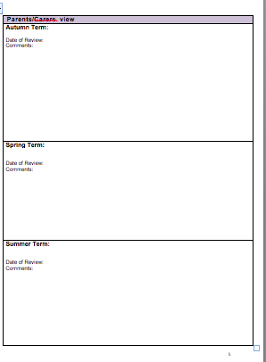
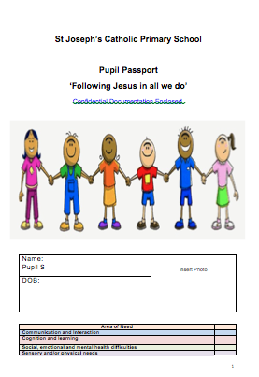
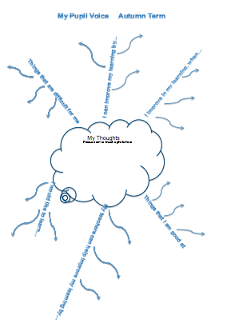
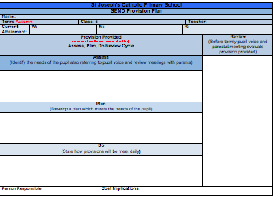
All our pupils on the SEND register have a pupil passport which follows them throughout their school life. Each term, a child will speak to their class teacher and are asked about how they feel about their learning and what staff can do to support them further.

Slide 14
Teachers’ responsibilities:
It is the responsibility of all our teachers to deliver Quality First teaching allowing access to a broad and balanced curriculum. Teachers will differentiate to enable pupils of different abilities and learning style to fulfil their potential.
There are three principles that are essential to developing our inclusive curriculum:
Having high expectations when planning for suitable differentiated learning experiences, regardless of prior attainment.
Responding to pupils’ diverse needs by addressing potential areas of difficulty and to remove barriers to pupil achievement.
Overcoming potential barriers to learning and assessment for individuals and groups of pupils.

Slide 15
Evaluating the Effectiveness of Provision for Children with SEND
Mrs J McDonagh (SENDCo) provides termly reports to the Headteacher and governing body on the progress of SEND Provision. This report includes:
Progress and Attainment of Pupils.
Interventions: Effectiveness on progress and attainment.
Interventions: Cost effectiveness.
Overview of Provision for each area of difficulty.
Overview of Cost effectiveness of provision.
Multi agency Support.
Cost effectiveness of outside agencies employed by St Joseph’s.
Staff Training.
Priorities for the following term.

Slide 16
During the movement of educational phases and year groups while at St Joseph’s, each child will be given a transition passport during the summer term to help with transition.
During the summer term, all classes experience two transition days in their next year group (Including Year Six who move to the school’s feeder school ‘Blessed Edward Oldcorne College’)
Pupil Passports are transferred to the next year group including the school’s feeder school ‘Blessed Edward Oldcorne College’
All Year Six pupils on the SEND Register have additional transition days at the school’s feeder school ‘Blessed Edward Oldcorne College’
Mrs McDonagh will liaise with the school’s feeder school ‘Blessed Edward Oldcorne College SENDCo and discusses the needs of any Year Six Pupils on the register.

Slide 17
School, Local and National Policies
All documents can found on the schools website
www.stjosephsworcester.co.uk
St Joseph’s Disability and Equality Policy 2018-2019
St Joseph’s Accessibility Plan 2018-2019
St Joseph’s SEND Policy 2018-2019
St Joseph’s SEND Offer and Information Report 2018-2019
St Joseph’s Mental Health and Wellbeing Policy 2018-2019
Worcestershire Local Authority Offer
Regulation 51 and Schedule 1 of the SEN and Disability Regulations 2014
Chapter 6 Children and Families Act 2014

Slide 18
Contact Information:
Head Teacher: Mrs Louise Bury
St Joseph’s Catholic Primary School.
Telephone:01905 452772
Email: office@st-josephs-pri.worcs.sch.uk
SENDCO : Mrs Joanne McDonagh
St Joseph’s Catholic Primary School.
Telephone: 01905 452772
Email:jmcdonagh@st-josephs-pri.worcs.sch.uk
Deputy SENDCOs: Miss Dean and Miss Hancox
St Joseph’s Catholic Primary School.
Telephone: 01905 452772
Email:LDean@st-josephs-pri.worcs.sch.uk SHancox@st-josephs-pri.worcs.sch.uk
SEND Governor: Mrs Claire Mulroy
St Joseph’s Catholic Primary School.
Telephone:01905 452772
Email: office@st-josephs-pri.worcs.sch.uk

