Slide 1
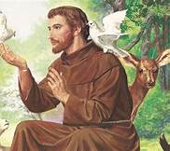
Year 2 Teaching Mass 5th October 2021
We remember St Francis of Assisi whose Feast day was yesterday 4th October.

Slide 2
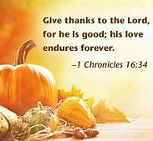
Prayer before Mass
God of love and light,
You call us to walk with you
every day of our lives.
Bless the work we do as we share the Word of God.
Let us learn ways of peace and understanding from
your son, Jesus.
Send your spirit to inspire our hearts and minds.
We ask this through Christ our Lord.
Amen

Slide 3
GATHER We gather with the parish family, thanking God that we are a school family

Slide 4
PENITENTIAL RITE
Lord have mercy
Christ have mercy
Lord have mercy
COLLECT
Let us pray...
Please sit after the Collect

Slide 5
Liturgy of the Word
We listen to God’s Word in the First Reading
Mrs Bury: A reading from the letter of St Paul to the Galatians
Mrs Bury: The Word of the Lord
Response: Thanks be to God

Slide 6
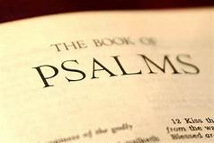
Liturgy of the Word ​
We respond to the first reading as we listen to the psalm
In the Psalms, you can find songs that celebrate the great things that God has done - songs that speak of trust in God - songs that call upon God in anger and despair...
Responsorial Psalm
The response is:
You are my inheritance, O Lord

Slide 7
Liturgy of the Word ​
Let us stand to greet the Gospel
Alleluia, Alleluia!
Blessed are you, Father,
Lord of heaven and earth,
For revealing the mysteries of the kingdom to mere children.
Alleluia!
The honouring of the Book of the Gospels reminds us of the power of words and especially, the power of the Word - the Word of God.
We stand up to acknowledge the presence of the Word among us, ready to receive the Word of God revealed in Jesus Christ.

Slide 8
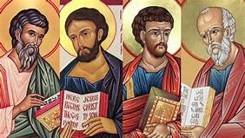
Liturgy of the Word ​​
The Book of the Gospels contain
the stories that form the backbone of our Faith.
The Gospel
Deacon Kevin: The Lord be with you.
All: And with your spirit.

Slide 9
As we say, “Glory to You, O Lord” we make a small sign of the cross on our forehead, lips and heart. "in my mind - on my lips - in my heart” .
There are so many actions that we do together in the Mass.
By the standing up together - saying words and doing actions together are a sign of our shared worship.
Deacon Kevin: A reading from the Gospel according to St Matthew
All: Glory to you O Lord.

Slide 10
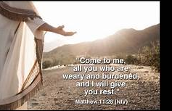
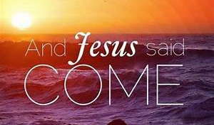

Slide 11
After the Gospel
Deacon Kevin: The Gospel of the Lord.
All: Praise to you, Lord Jesus Christ.

Slide 12
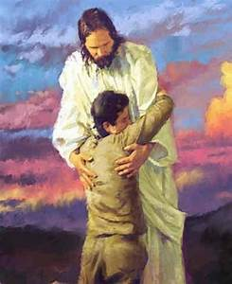
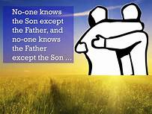
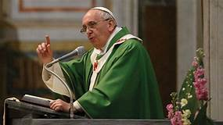
The Homily
The purpose of the homily is to explain the meaning of the scripture readings and how they link to our lives.

Slide 13
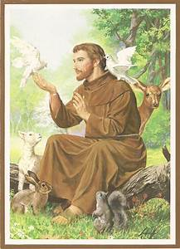
Prayers of the Faithful
These are prayers said publically. We are the faithful who pray these prayers. We offer our love to Jesus
We think of others in our prayers and send all of our prayers to Jesus in shared response.
‘Lord hear us,
Lord graciously hear us.’

Slide 14
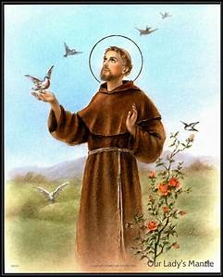
Prayers of the Faithful
We pray for the Church and church leaders, may they follow the example of St Francis as they work to bring peace to the world.
Lord hear us,
Lord graciously hear us.

Slide 15
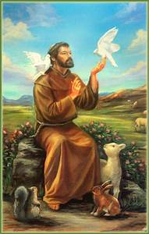
Prayers of the Faithful
We pray for the Pope and clergy everywhere, may the example of St Francis inspire them as they continue to encourage us all to care for God’s creation.
Lord hear us,
Lord graciously hear us.

Slide 16
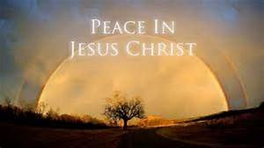
Prayers of the Faithful
We pray for the sick and those who suffer, may Christ's love touch them with comfort and peace.
Lord hear us,
Lord graciously hear us.

Slide 17
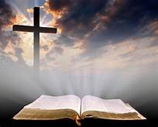
Prayers of the Faithful
We pray for all who have died, may they rest in peace and rise in glory.
Lord hear us,
Lord graciously hear us.

Slide 18
Prayers of the Faithful
We pray for our school and parish community. As St Francis showed love for all creation, help all of us to care for and respect God’s wonderful world.
Lord hear us,
Lord graciously hear us.

Slide 19
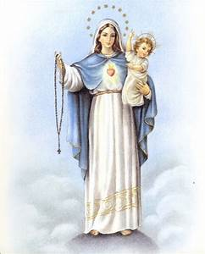
Prayers of the Faithful
We offer all our prayers to Mary ​
in our final prayer as she is our holy ​
mother and cares for us deeply like ​
any mother.​
During this month of October, let us offer our prayers to Our Lady of the Rosary as we sing together:
Hail Mary…

Slide 20
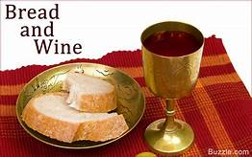
Offertory Procession of Gifts

Slide 21
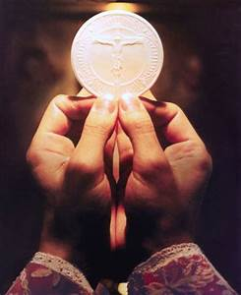
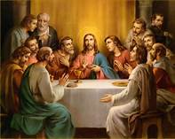
Liturgy of the Eucharist
The Holy Eucharist is a sacrament and a sacrifice. In it we remember the Last Supper Jesus had with his disciples
In the Holy Eucharist, under the appearances of bread and wine, the Lord Jesus Christ is contained, offered, and received.

Slide 22
Fr Amal: Blessed are you, Lord God of all creation, for through your goodness we have received the bread we offer you: fruit of the earth and work of human hands, it will become for us the bread of life.
All: Blessed be God for ever.

Slide 23
Fr Amal: Blessed are you, Lord God of all creation, for through your goodness we have received the wine we offer you: fruit of the vine and work of human hands, it will become our spiritual drink.
All: Blessed be God for ever.

Slide 24
Orate Fratres
Please stand:
Fr. Amal: Pray, brothers and
sisters,
that my sacrifice and
yours may be acceptable to
God,
the almighty Father.
“Pray, brothers and sisters” ends the preparation at the beginning of the Liturgy of the Eucharist.
The gifs of bread and wine are presented; the priest will pray while lifting the gifts slightly above the altar, and, after saying a short private prayer that our offerings and ourselves might be acceptable, washes his hands at the side of the altar.

Slide 25
All: May the Lord accept the sacrifice at your hands for the praise and glory of his name, for our good and the good of all his holy
Church.

Slide 26
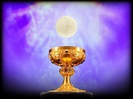
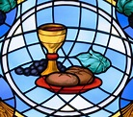
The priest will now say the Eucharistic prayer.
In the Eucharistic Prayer the Church asks for the power of the Holy Spirit to consecrate the bread and wine to become Christ’s Body and Blood.
This is the central part of the mass.
Jesus' body is then given in Holy Communion.
We take part in our shared responses.

Slide 27
Preface Dialogue
This marks the beginning of the Eucharistic prayer.
Fr. Amal: The Lord be with you.
People: And with your spirit.
Fr. Amal: Lift up your hearts.
The Prayer begins with the preface, lifting our hearts up to the Father. Then comes the Sanctus, proclaiming God’s holiness and glory that fills the universe.​

Slide 28
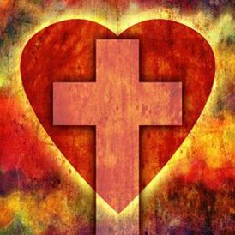
People: We lift them up to the Lord.
Fr. Amal: Let us give thanks to the Lord our God.
People: It is right and just.

Slide 29
The Sanctus
Holy, Holy, Holy Lord God of hosts,
Heaven and earth are full of your glory.
Hosanna in the highest.

Slide 30
Blessed is he who comes
In the name of the Lord.
Hosanna in the highest.
Please sit

Slide 31
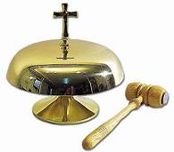
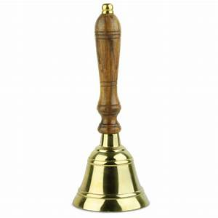
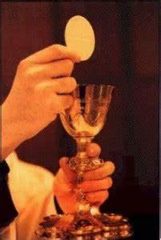
Consecration
The great mystery of the consecration is central to our faith and belief that Jesus died for us and we receive his body in Holy Communion.
The ringing of the bell indicates that something special has taken place.
Listen for the number of times the bell is rung each time...3 times for Father, Son and Holy Spirit.

Slide 32
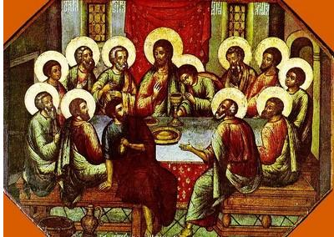
The Mystery of Faith
In the consecration a huge change has now taken place,
the great mystery of the consecration is central to our faith and belief that Jesus
Died for us and we receive his body in Holy Communion.
Fr. Amal: The mystery of faith
People: When we eat this Bread and drink this Cup, we proclaim your Death, O Lord, until you come again.

Slide 34
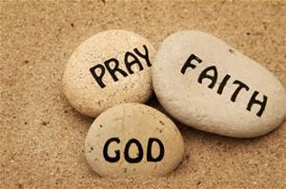
The Communion Rite
In the communion rite, we think about the great gift of Jesus which we are about to receive in communion. We are all individuals but we pray together the Lord's prayer as God's children.
We ask for forgiveness and reconciliation with Jesus.
A time of personal reflection.​
Fr Amal: At the Saviour’s command and formed by divine teaching, we dare
to say:
No Amen is said at the end of the Our Father – we say the great Amen before the sign of peace

Slide 35
Our Father, who art in heaven
hallowed be thy name.
Thy kingdom come,
Thy will be done,
On earth as it is in heaven.
Give us this day our daily bread and forgive us our trespasses
As we forgive those who trespass against us.
And lead us not into temptation
But deliver us from evil

Slide 36
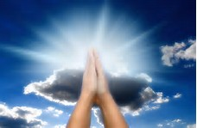
Fr Amal: Deliver us, Lord, we pray, from every evil, graciously grant peace in our days,
that, by the help of your mercy, we may be always free from sin and safe from all distress, as we await the blessed hope and the coming of our Saviour, Jesus Christ.

Slide 37
All: For the kingdom, the power and the glory are yours
now and forever.

Slide 38
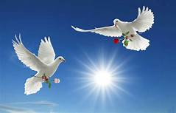
Fr Amal: Lord Jesus Christ, who said to your Apostles:
Peace I leave you, my peace I give you,
look not on our sins,
but on the faith of your
Church,

Slide 39
Amen means 'it is so' or 'so be it'. In Hebrew it is translated as 'truth' and 'certainty'
and graciously grant her peace and unity in accordance with your will.
Who live and reign for ever and ever.
All: Amen

Slide 40
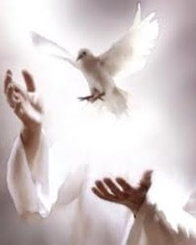
PEACE
We give each other the sign of peace
Father Amal: The peace of the Lord be with you always.​ ​ People: And with your spirit.​ ​ ​ ​ ​

Slide 41
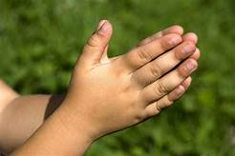
PEACE
The sign if peace is given to show that that we are at peace with one another.
It shows that we have a peace with each other and are a community working for Jesus.
Deacon Kevin: Let us offer each other the sign of peace​

Slide 42
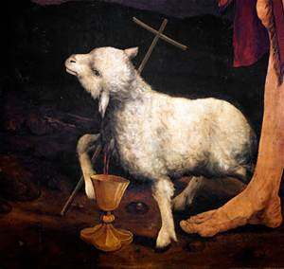
Lamb of God, you take away the sins of the world: have mercy on us.
Lamb of God, you take away the sins of the world: have mercy on us.
Lamb of God, you take away the sins of the world: grant us peace.
Please sit

Slide 43
Jesus is the Lamb of God who suffered, died and rose again for us. We offer our hearts to him and promise to follow him in all we do.
Lamb of God
Fr. Amal: Behold the Lamb of God, behold him who takes away the sins of the world.
Blessed are those called to the supper of the Lamb.

Slide 44
All: Lord, I am not worthy that you should enter
under my roof,
but only say the word and my soul shall be healed.

Slide 46
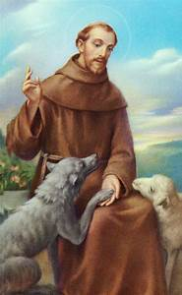
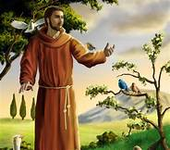

Slide 47
The Final Blessing
Fr. Amal: The Lord be with you.
People: And with your spirit.
Fr. Amal:
May almighty God bless you,
the Father, and the Son,
and the Holy Spirit.
People: Amen.

Slide 48
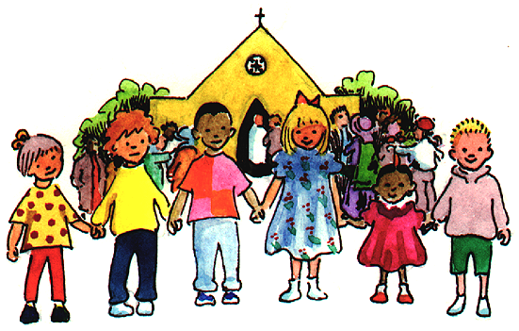
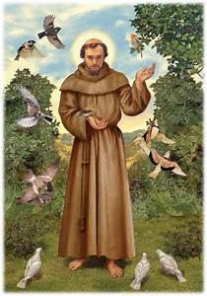
SENDING OUT
We go out to love and help others and to tell them about Jesus.
AMEN

