Slide 1
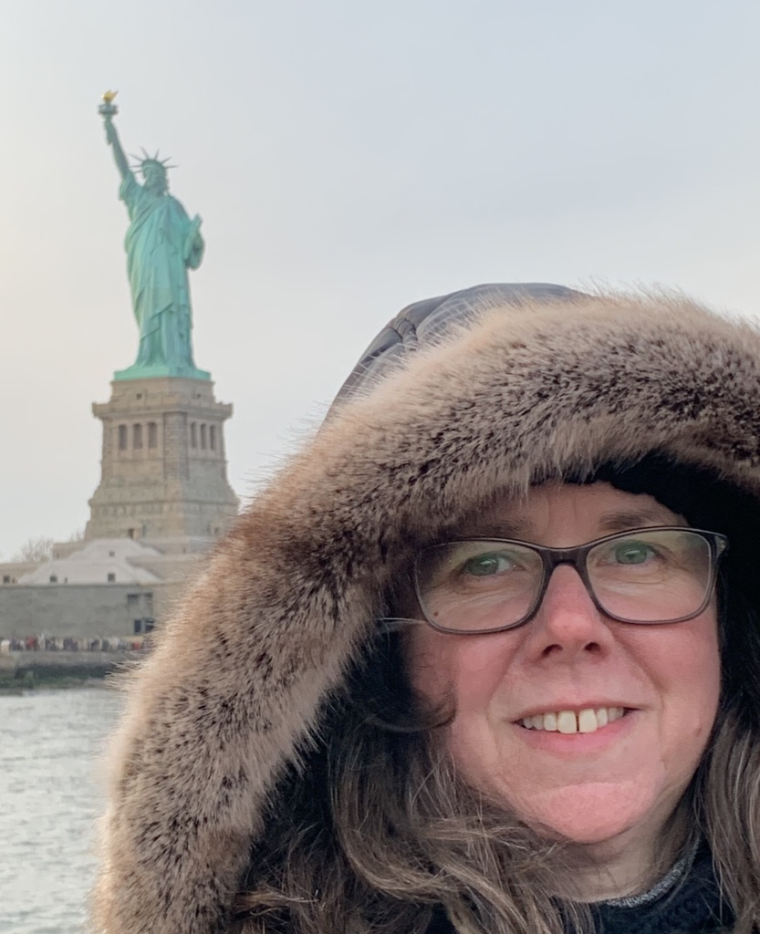
Hi!
I’m Mrs Hackley and I am going to be your new teacher when you move into Year 6.

Slide 2
MY FAMILY
I am the proud mum of three beautiful girls – Amy, Lottie and Sophie.
Amy, my eldest, has two children of her own who I dote over and am constantly giving hugs and kisses. Yes, I’m a big softy. Their names are Lily and Rory.
My husband is Andy and he is an executive headteacher of two schools in Worcester.

Slide 3
ALL ABOUT ME!
My birthday is in May and I have only had to spend two of my birthdays at school. That was down to the Queen having two major celebrations!
I was born in Birmingham and have one sister. She is older than me by exactly 20 months, 4 days and 1 hour.
I am extremely proud to be the aunty of her two children, Daniel and Hannah.
I love spending time with my sister and her family: going for walks and having barbeques.

Slide 4
Did you know?
My favourite food is chocolate. Not just any chocolate – it has to be Cadbury’s Twirls. In either way – bites or the bars.
My favourite animals are dogs and cats.
I am petrified of snakes.
I love reading and can often be found with my head in a book.
My favourite sport is swimming.
I love dancing to music and visiting musicals in London.

Slide 5
MY FAVOURITE SUBJECTS
I love English – I am happiest when reading or writing.
Maths is fun too. I love the order it can bring to your day.
History is also another passion of mine, especially the topics we look at in Year 6.
Then there is Art. I love drawing. Not very keen on painting as it is messy and I really do not like a mess.

Slide 6
Now, what about you?
Who are you?
What is your favourite food?
Which subject do you like best at school?
If you were to be an animal, which animal would you be and why?
Can you draw me a self portrait?

