Slide 1
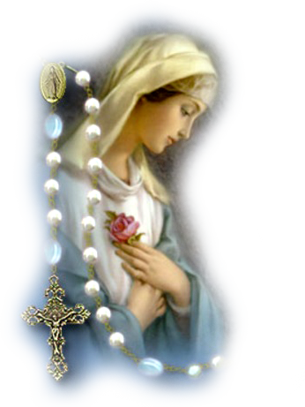
The Rosary

Slide 2
How to pray the Rosary
Joyful
Mysteries
Mondays & Saturdays
Luminous Mysteries
Thursdays
Sorrowful
Mysteries
Tuesdays &
Fridays
Glorious
Mysteries
Wednesdays & Sundays
The Creed
Hail Holy Queen
Other Prayers for Mary

Slide 3
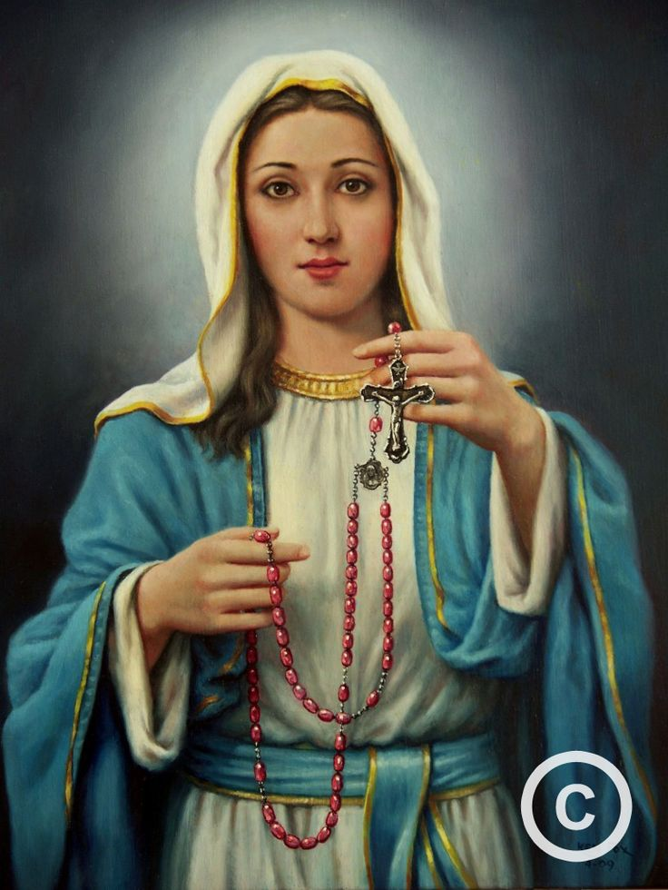
The Joyful Mysteries
Mondays and Saturdays

Slide 4
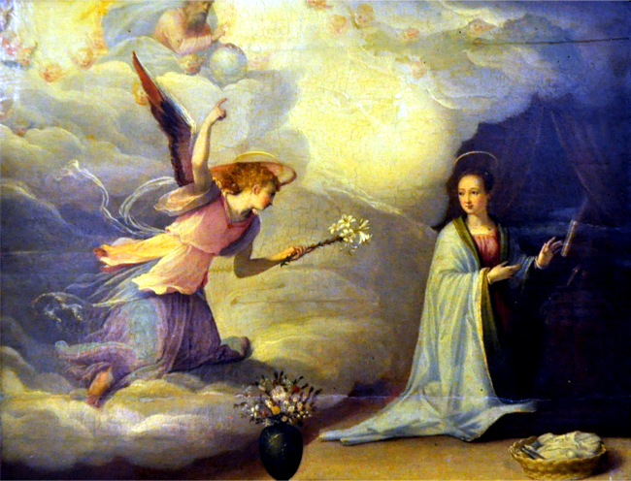
1st Joyful Mystery:
The Annunciation of Gabriel to Mary
Reflect on... The humility of the Blessed Virgin when the Angel Gabriel greeted her with these words: "Hail full of grace". Luke 1:26
.

Slide 5
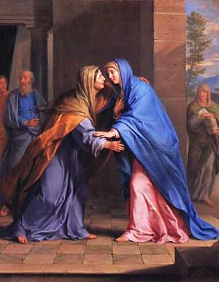
2nd Joyful Mystery:
The Visitation of Mary to Elizabeth
Reflect on... Mary shows charity in visiting her cousin Elizabeth and remaining with her for three months before the birth of John the Baptist. Luke 1:39
.

Slide 6
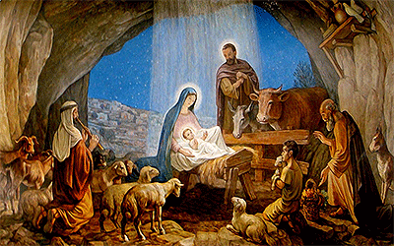
3rd Joyful Mystery:
The Birth of Jesus
Reflect on... The poverty, so lovingly accepted by Mary when she placed the Infant Jesus, our God and Redeemer, in a manger in the stable of Bethlehem. Luke 2:1
.

Slide 7
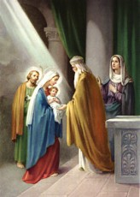
4th Joyful Mystery:
The Presentation of Jesus in the Temple
Reflect on... Mary's obedience to the law of God in presenting the Child Jesus in the Temple. Luke 2:22
.

Slide 8
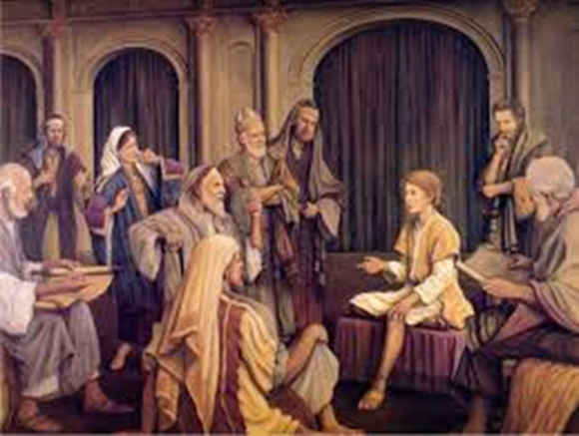
5th Joyful Mystery:
Finding Jesus in the Temple
Reflect on... The deep sorrow with which Mary sought the Child Jesus for three days, and the joy with which she found Him in the midst of the Teachers of the Temple. Luke 2:41
.

Slide 9
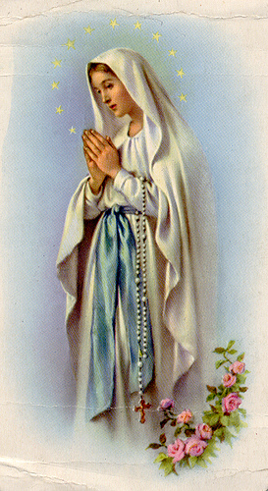
The Luminous Mysteries
Thursdays

Slide 10
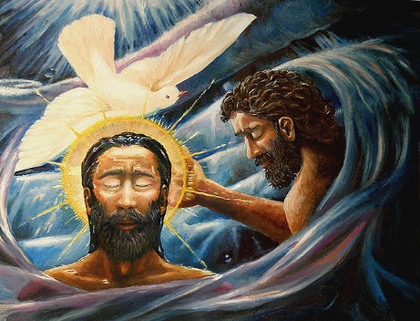
1st Luminous Mystery:
The Baptism of Jesus in the River Jordan
And a voice came from the heavens, saying, "This is my beloved Son, with whom I am well pleased." Matthew 3:17
.

Slide 11
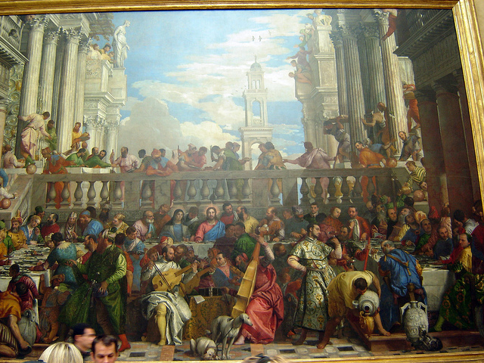
2nd Luminous Mystery:
The Wedding at Cana, Christ Manifested
Jesus did this as the beginning of his signs in Cana in Galilee and so revealed his glory, and his disciples began to believe in him. John 2:11
.

Slide 12
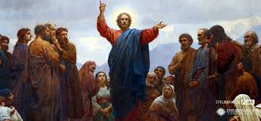
3rd Luminous Mystery:
The Proclamation of the Kingdom of God
Jesus came to Galilee proclaiming the gospel of God: "This is the time of fulfillment. The kingdom of God is at hand. Repent, and believe in the gospel." Mark 1:15
.

Slide 13
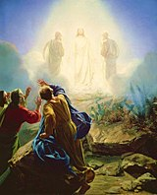
4th Luminous Mystery:
The Transfiguration of Jesus
And he was transfigured before them; his face shone like the sun and his clothes became white as light. Matthew 17:2
.

Slide 14
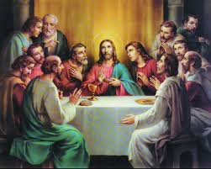
5th Luminous Mystery:
The Last Supper, the Holy Eucharist
While they were eating, Jesus took bread, said the blessing, broke it, and giving it to his disciples said, "Take and eat; this is my body." Then he took a cup, gave thanks, and gave it to them, saying, "Drink from it, all of you, for this is my blood of the covenant, which will be shed on behalf of many for the forgiveness of sins. Matthew 26:26
.

Slide 15
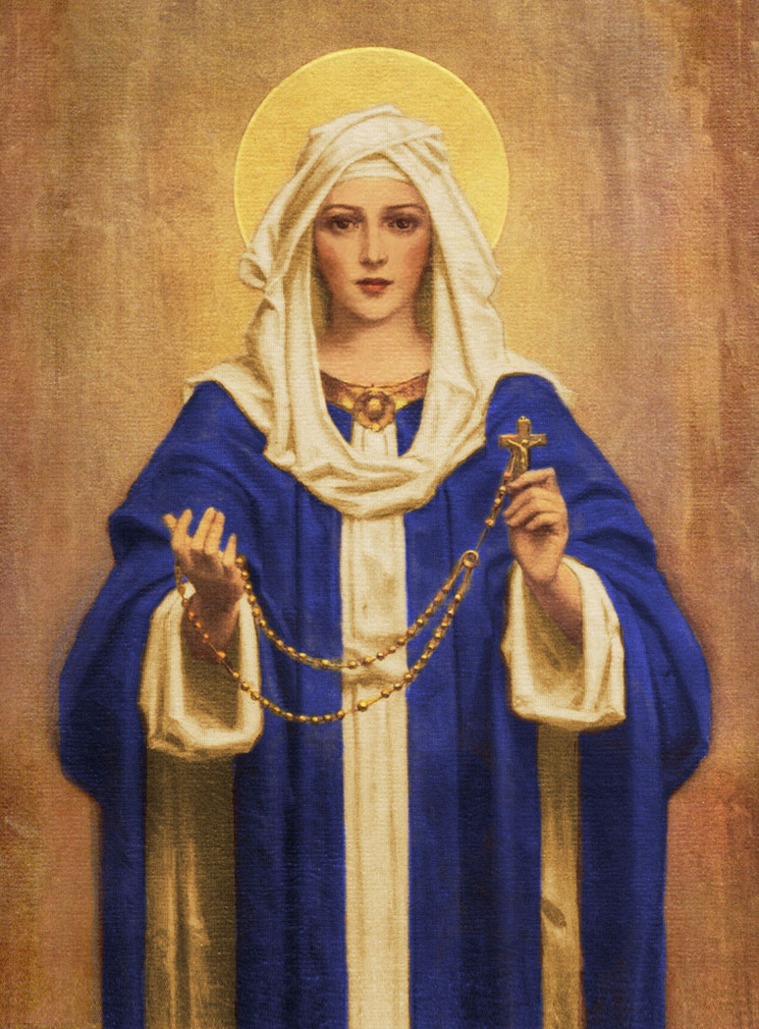
The Sorrowful Mysteries
Tuesdays and Fridays

Slide 16
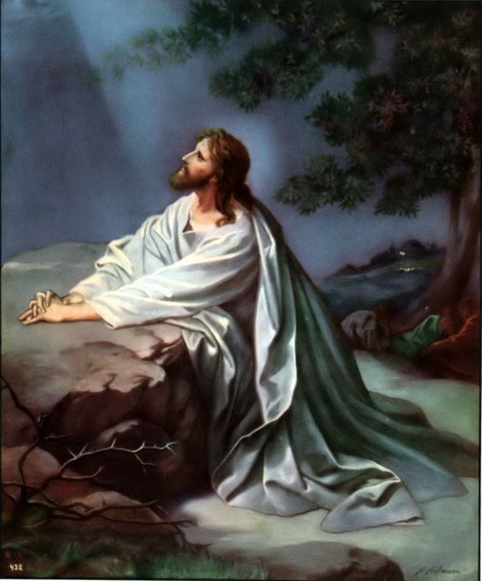
1st Sorrowful Mystery:
Agony of Jesus in the Garden
Reflect on... Our Lord Jesus in the garden of Gethsemane, suffering a bitter agony for our sins. Matthew 26:36
.

Slide 17
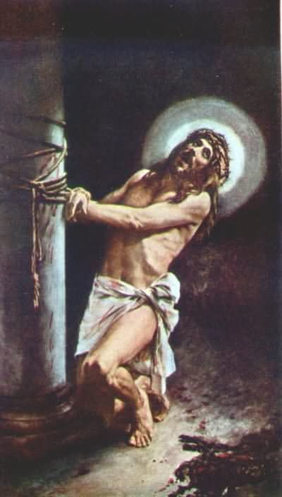
2nd Sorrowful Mystery:
Jesus is Scourged at the Pillar
I Desire a Spirit of Mortification Reflect on... The cruel scourging at the pillar that our Lord suffered; the heavy blows that tore His flesh. Matthew 27:26
.

Slide 18
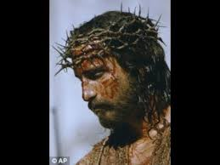
3rd Sorrowful Mystery:
Jesus is Crowned With Thorns
Reflect on... The crown of sharp thorns that was forced upon our Lord's Head and the patience with which He endured the pain for our sins. Matthew 27:27
.

Slide 19
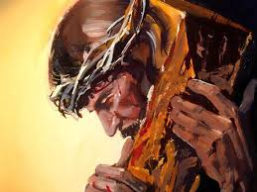
4th Sorrowful Mystery:
Jesus Carries His Cross
Reflect on... The heavy Cross, so willingly carried by our Lord, and ask Him to help you to carry your crosses without complaint. Matthew 27:32
.

Slide 20
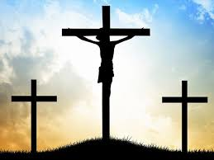
5th Sorrowful Mystery:
The Crucifixion of Jesus
Reflect on... The love which filled Christ's Sacred Heart during His three hours' agony on the Cross, and ask Him to be with you at the hour of death. Matthew 27:33
.

Slide 21
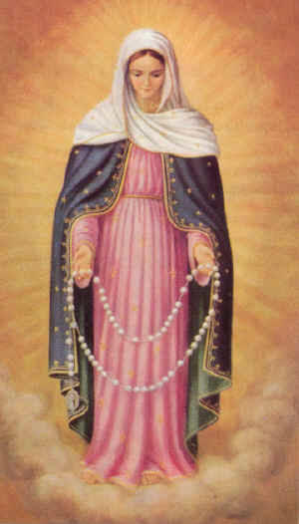
The Glorious Mysteries
Wednesdays and Sundays

Slide 22
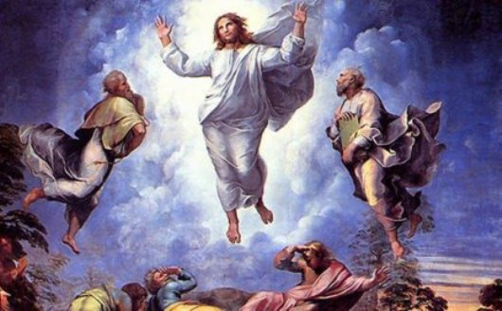
1st Glorious Mystery:
The Resurrection of Jesus
Reflect on... Christ's glorious triumph when, on the third day after His death, He arose from the tomb and for forty days appeared to His Blessed Mother and to His disciples. John 20:1
.

Slide 23
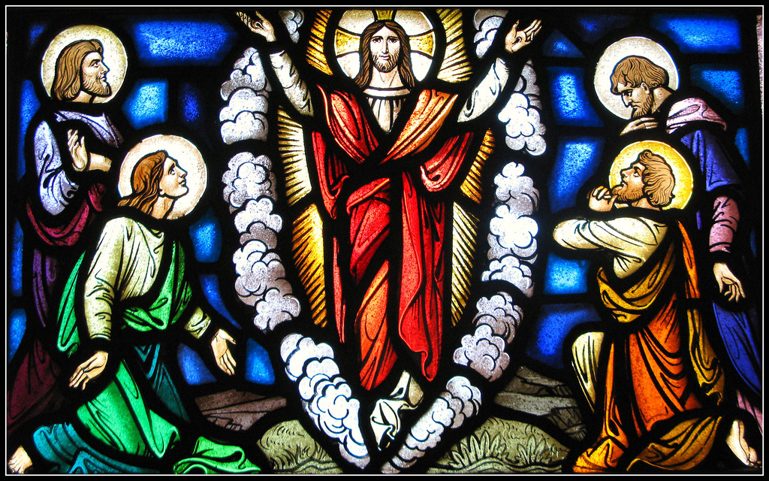
2nd Glorious Mystery:
The Ascension of Jesus
Reflect on... The Ascension of Jesus Christ, forty days after His glorious Resurrection, in the presence of Mary and His disciples. Luke 24:36
.

Slide 24
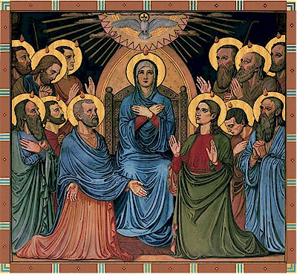
3rd Glorious Mystery:
The Descent of the Holy Spirit at Pentecost
Reflect on... The descent of the Holy Spirit upon Mary and the Apostles, under the form of tongues of fire, in fulfillment of Christ's promise. Acts 2:1
.

Slide 25
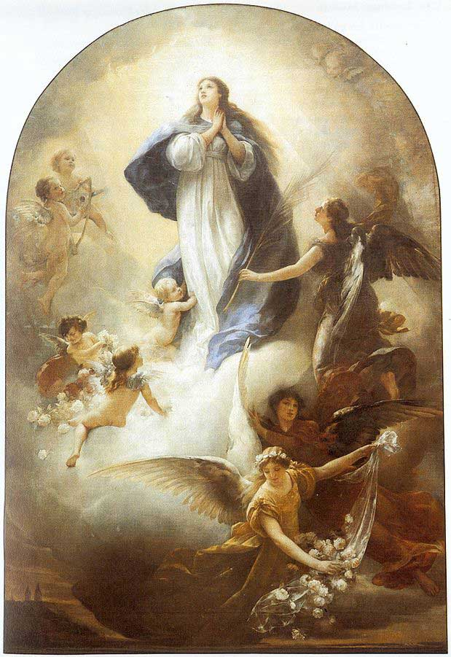
4th Glorious Mystery:
The Assumption of Mary into Heaven
Reflect on... The glorious Assumption of Mary into Heaven, when she was united with her Divine Son.
.

Slide 26
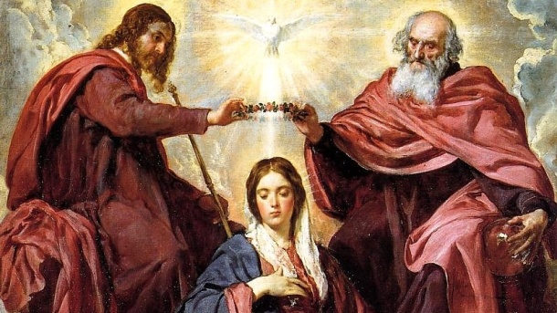
5th Glorious Mystery:
The Coronation of Mary as Queen of Heaven and Earth
Reflect on... The glorious crowning of Mary as Queen of Heaven by her Divine Son, to the great joy of all the Saints.
.

Slide 27
The Creed
I believe in God, the Father Almighty, Creator of Heaven and earth; and in Jesus Christ His only Son, Our Lord; who was conceived by the Holy Spirit, born of the Virgin Mary, suffered under Pontius Pilate, was crucified, died and was buried. He descended into Hell; the third day He arose again from the dead; He ascended into Heaven, and is seated at the right hand of God, the Father Almighty; from thence He shall come to judge the living and the dead. I believe in the Holy Spirit, the Holy Catholic Church, the communion of Saints, the forgiveness of sins, the resurrection of the body, and life everlasting. Amen.

Slide 28
Hail Holy Queen
Hail! Holy Queen, Mother of Mercy, our life, our sweetness and our hope.
To you do we cry, poor banished children of Eve. To you do we send up our sighs, mourning and weeping in this valley of tears.
Turn then, O most gracious advocate, your eyes of mercy towards us; and after this our exile, show unto us the blessed fruit of your womb, Jesus.
O clement! O loving! O sweet Virgin Mary!
Pray for us, O Holy Mother of God, that we may be made worthy of the promises of Christ.

Slide 29
Rosary Prayer
O God, whose only-begotten Son, by His life, death and resurrection, has purchased for us the rewards of eternal life; grant, we beseech Thee, that, meditating upon these mysteries of the Most Holy Rosary of the Blessed Virgin Mary, we may imitate what they contain and obtain what they promise, through the same Christ our Lord. Amen.

Slide 30
Other prayers to Mary…

Slide 31
The Angelus
The Angel of the Lord declared to Mary:
Hail Mary…
Behold the handmaid of the Lord:
Hail Mary…
And the Word was made flesh:
Pray for us, O holy Mother of God.
and she conceived of the Holy Spirit.
Holy Mary…
be it done to me according to your word.
Holy Mary…
and dwelt among us
That we may be made worthy of the promises of Christ.

Slide 32
Let us pray:
Pour forth, we beseech you, O Lord,
your grace into our hearts,
that we to whom the incarnation of Christ, your Son,
was made known by the message of an angel,
may be brought by his passion and cross
to the glory of his resurrection,
through Christ our Lord. Amen.

Slide 33
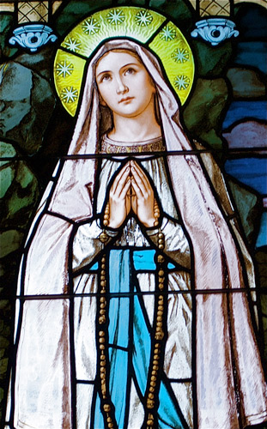
The Memorare
Remember, O most loving Virgin Mary,
that it is a thing unheard of,
that anyone ever had recourse to your protection,
implored your help,
or sought your intercession,
and was left forsaken.

Slide 34
Filled therefore with confidence in your
goodness
I fly to you, O Mother, Virgin of virgins.
To you I come, before you I stand,
a sorrowful sinner.

Slide 35
Despise not my poor words,
O Mother of the Word of God,
but graciously hear
and grant my prayer. Amen.

