Slide 1
Science at St Joseph’s

Slide 2
When I leave St Joseph’s…
I am going to be a Scientist…
What will this look like?

Slide 3
I will be able to…
think independently and ask questions about working scientifically and the knowledge and skills that it brings.

Slide 4
I will have…
confidence and competence in a full range of practical skills, taking the initiative in, for example, planning and carrying out scientific investigations.

Slide 5
I will have…
excellent scientific knowledge and understanding which is demonstrated in written and verbal explanations, solving challenging problems and reporting scientific findings.

Slide 6
I will have…
high levels of originality, imagination or innovation in the application of skills.

Slide 7
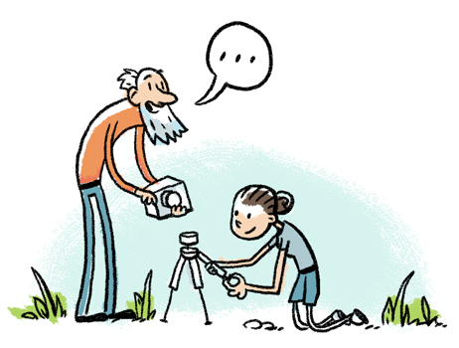
I will be able to…
undertake practical work in a variety of contexts, including fieldwork.

Slide 8
I will have…
a passion for science and its application in past, present and future technologies.

