Slide 1
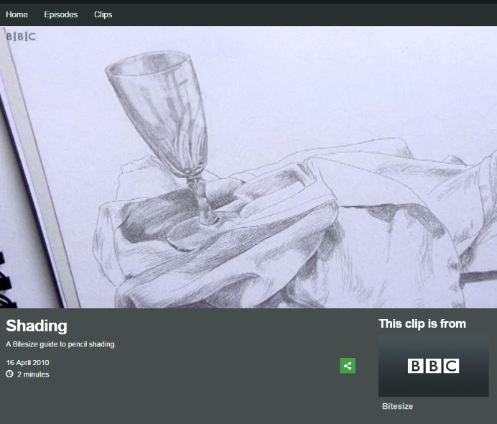
LO: explore the relationships between texture, line and tone
There are lots of different techniques that we can use to make our drawings look more realistic. We can start by drawing the outlines of shapes and then building up texture and shade.
Watch the video to find out more about shading
Click on the image to watch the clip:

Slide 2
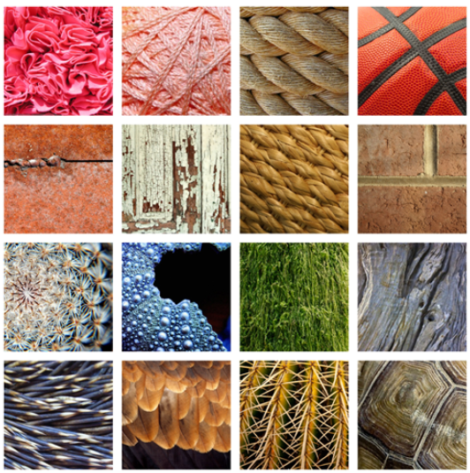
Drawing texture with pencil
Texture is the feeling, appearance or consistency of an object or material.
It can be natural or man-made, functional or decorative. Artists try to replicate the texture of the subject to make their work look as realistic as possible.
Can you tell what some of these objects are?
Think about how they feel?

Slide 3
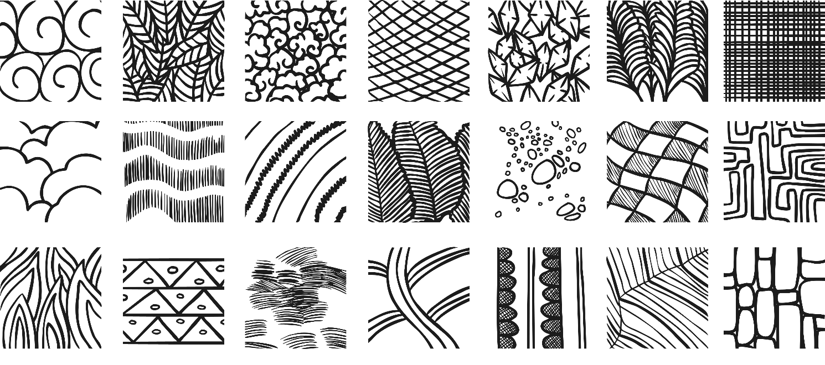
Drawing texture with pencil
Look at the images below. They have used line to make different textures.
Task 1: Complete the Drawing Texture sheet. You don’t have to print the worksheet, you can copy the textured squares onto a piece of paper.
It is important that you don’t rush. Focus on small, delicate pencil strokes

Slide 4
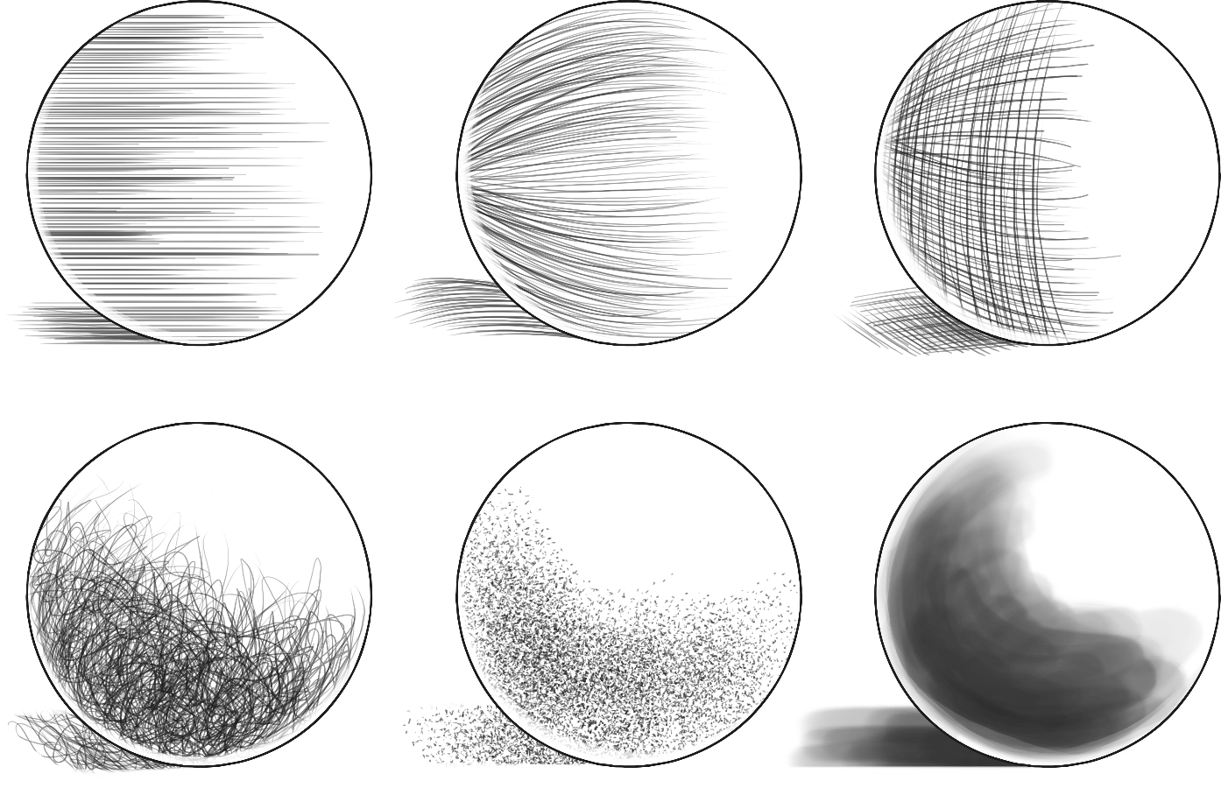
Drawing texture using line and tone
There are also different methods of shading and showing areas of light and dark on a surface.
Task 2: Can you complete the shading circles activity using each of the techniques identified below.
Hatching
Contour Hatching
Cross Hatching
Random Hatching
Stippling
Ink Wash

Slide 5
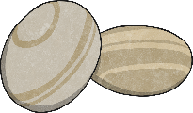
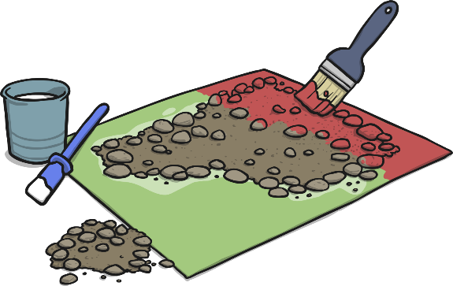
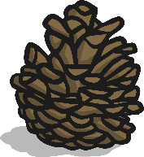
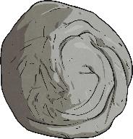
Activity
Different textures are all around us. Find objects or materials within the room with an interesting texture. Try drawing the texture using line and tone.

