Slide 1
Welcome to Year 4
With Mrs Boswell & Mr Thomas

Slide 2
Staff in Lower Key stage 2
Mrs Boswell – Year 3 Oak
Mr Thomas – Year 3 Pear
Mrs Nickless - Year 4 Oak
Mr Bowring – Year 4 Pear
Ms Evans- TA for Year 3
Miss Hackett –TA for Year 3
Mrs Jones – TA for Year 4
Mrs Collingwood – TA for Year 4
Mrs Jamroz

Slide 3
Catholic Life
As a catholic school we work hard to promote a catholic ethos with the children. The following shows some ways in which we do this;
We say prayers first thing in the morning, before lunch and before they go home. These prayers will be the same prayers your child has said since Reception.
The prayers we learn in Year 3 are; The act of sorrow, Novena prayers, Memorare (May), Mysteries of the rosary and the prayer said before communion (Lord I am not worthy…).
Children will also have the opportunity to write their own prayers, specifically, their own prayers of the faithful for Mass and a prayer for after communion as part of their First Holy Communion preparation.

Slide 4
Collective worship takes place in class on Wednesdays or Thursday.
The children attend Mass or a prayer service regularly.
If it is your child's class Mass we will let you know as you would be more than welcome to attend. (You can also find this information on the newsletter).
Two children, from each year 3 class, are chosen once a term to be Liturgy Planners.

Slide 5
First Holy Communion
In Year 3, there will be the opportunity for Catholic children to receive the sacraments of Reconciliation and First Holy Communion.
The preparation for this forms a large part of the Year Three RE curriculum therefore all children in the class will learn about these important sacraments.
We will hold parent/pupil workshops and there will school/parish Masses for you and your child to attend throughout the year.

Slide 6
Curriculum
Curriculum letters will be sent out at the beginning of every term as usual.
Ancient Egypt & The Stone Age
Please look at the school website for useful information including:
our Year 3 webpage which we will update regularly with updates about our learning

Slide 7
On Line Safety
Online safety is taught in class once per half term. Outside of these lessons it is something which we seek to promote an open discussion around with children.
Online safety covers a wide range of areas. From protecting children from harm by others to equipping children with an understanding of healthy and unhealthy use of technology (screen time for example).
Please do not hesitate to contact your child’s class teacher or Mr Bowring, our online safety co-ordinator, should you have any concerns about your child’s online activity or a wider online safety issue.
Alternatively, you can report a concern about the way someone has been communicating online through the Child Exploitation and Online Protection Command (CEOP) here: https://www.ceop.police.uk/ceop-reporting/

Slide 8
During Transition days, your child’s new teacher delivered a session on online safety, considering how best to safely use the school IT equipment.
An agreement was also shared with the children, which their teacher explained to them and they signed. This agreement, and the powerpoint which was used to deliver the lesson can be viewed on our school website on the e-safety page (under parents)
If you haven’t already, please could you use the links
below to sign this electronically yourself as a parent/Carer.
Key Stage 1
https://forms.office.com/e/icLhK4MGuW
Key stage 2
https://forms.office.com/e/iPuzF3B44Y

Slide 9
Working in partnership with parents to tackle online safety
During the next academic year, as a school we want to increase our reach and engagement with our parents when it comes to online safety issues.
If you would like to be a part of this journey as a parent, liaising with us as a school on online safety issues, please contact Mr Bowring at
year5oakparents@st-josephs-pri.worcs.sch.uk
If you haven't already done so, please sign up to the National Online Safety app here, when you register, set yourself as a parent to access all of the online safety resources available
https://nationalonlinesafety.com/enrol/st-joseph-s-catholic-primary-school-wr4-9pg

Slide 10
Homework
Homework to be in on Thursday and will be marked and returned Friday.
Spellings – 3 games on EdShed per week tests weekly.
Times tables – TTRS 10 mins minimum

Slide 11
Reading expectations
Reading is the most important thing you can do at home with your child.
Children must read to an adult at least 3 times a week.
Three comments per week in their reading record book by an adult.

Slide 12
Rewards and sanctions
Positive behaviour is praised.
All children are aware of the consequences of their words and actions.
All classrooms display the following…

Slide 13
 | Actions affecting school community Persistent bullying Significant damage | Fixed term exclusion Removal from playtimes and lunchtimes Family restorative practise Involvement of local police – whole class talk / assembly / small group etc as needed
 | Actions affecting the class Disrupting lessons Threatening or abusive behaviour | Removal from classroom Meeting with parents Individual Behaviour Plan Loss of free time – 15mins x 2
 | Actions affecting another person Being disrespectful Intentionally hurting someone else | In-class isolation Work in a separate room Communication with parents Behaviour reflections Loss of free time – 15 mins
 | Actions affecting you Not engaging with learning Being unsafe online | Talk with an adult Loss of free time – 5 mins Catch up on missed work Reflection time
 | You are getting it right when you are… Respectful, Trustworthy, Friendly, Responsible, Forgiving Following Jesus In All You Do | Praise Certificates Stickers House Points Whole Class Rewards

Slide 14
KS2 Uniform
White shirt/blouse and school tie or white polo shirt with or without school logo
School sweatshirt/cardigan with logo
Grey trousers
Grey skirt/pinafore
White or grey socks or grey tights
Black smart low shoes
In the Spring/ Summer term children may wear a green check dress or grey shorts.

Slide 15
KS2 PE kit
Indoor P.E. Kit
White P.E. T-shirt (plain or with school logo)
Black shorts or skorts of a reasonable length may also be worn (not lycra or cycling shorts)
Outdoor P.E. Kit
Black jogging bottoms (for outdoor P.E.)
Plain black hoodie
Dark Coloured Trainers
ALL PE kit needs to be labelled and if brought into school, kept in a named green kit bag
Please note that branded sportswear is NOT part of our school uniform policy

Slide 16
Lunch and break times
Break time in Year 3 and 4 is at 10:00am.
Lunch time for KS2 is at 12.30pm- 1.30pm.
Lunches must be ordered and paid for from the school website
https://www.stjosephsworcester.co.uk/parents/catering

Slide 17
You will need…
Pencil case – small enough to fit into a tray under your desk
Writing pencil
Rubber
Sharpener
Green highlighter
Purple biro pen
30cm ruler
Glue stick
Water bottle
Snack
Packed lunch if you are not ordering a school lunch

Slide 18
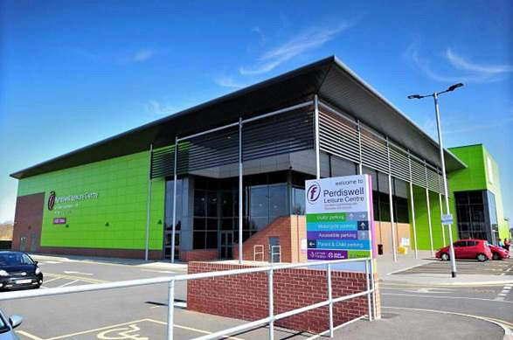
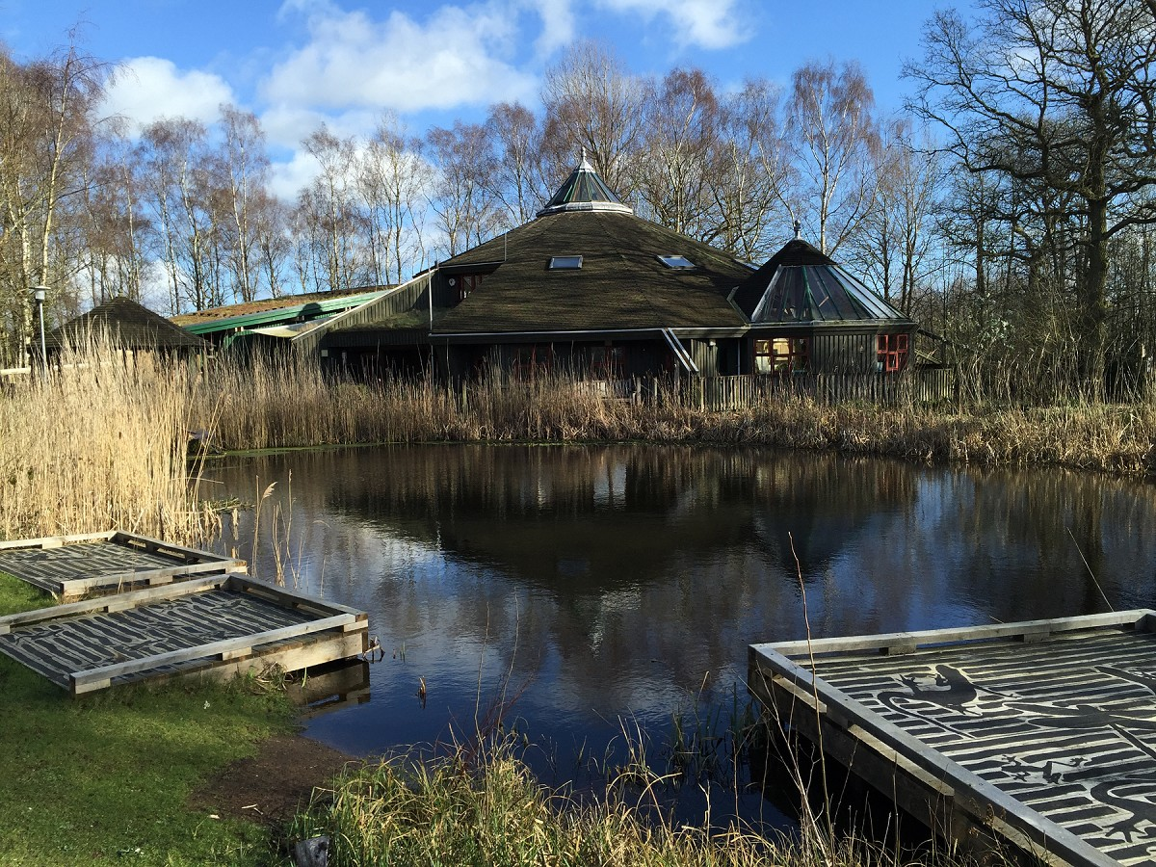
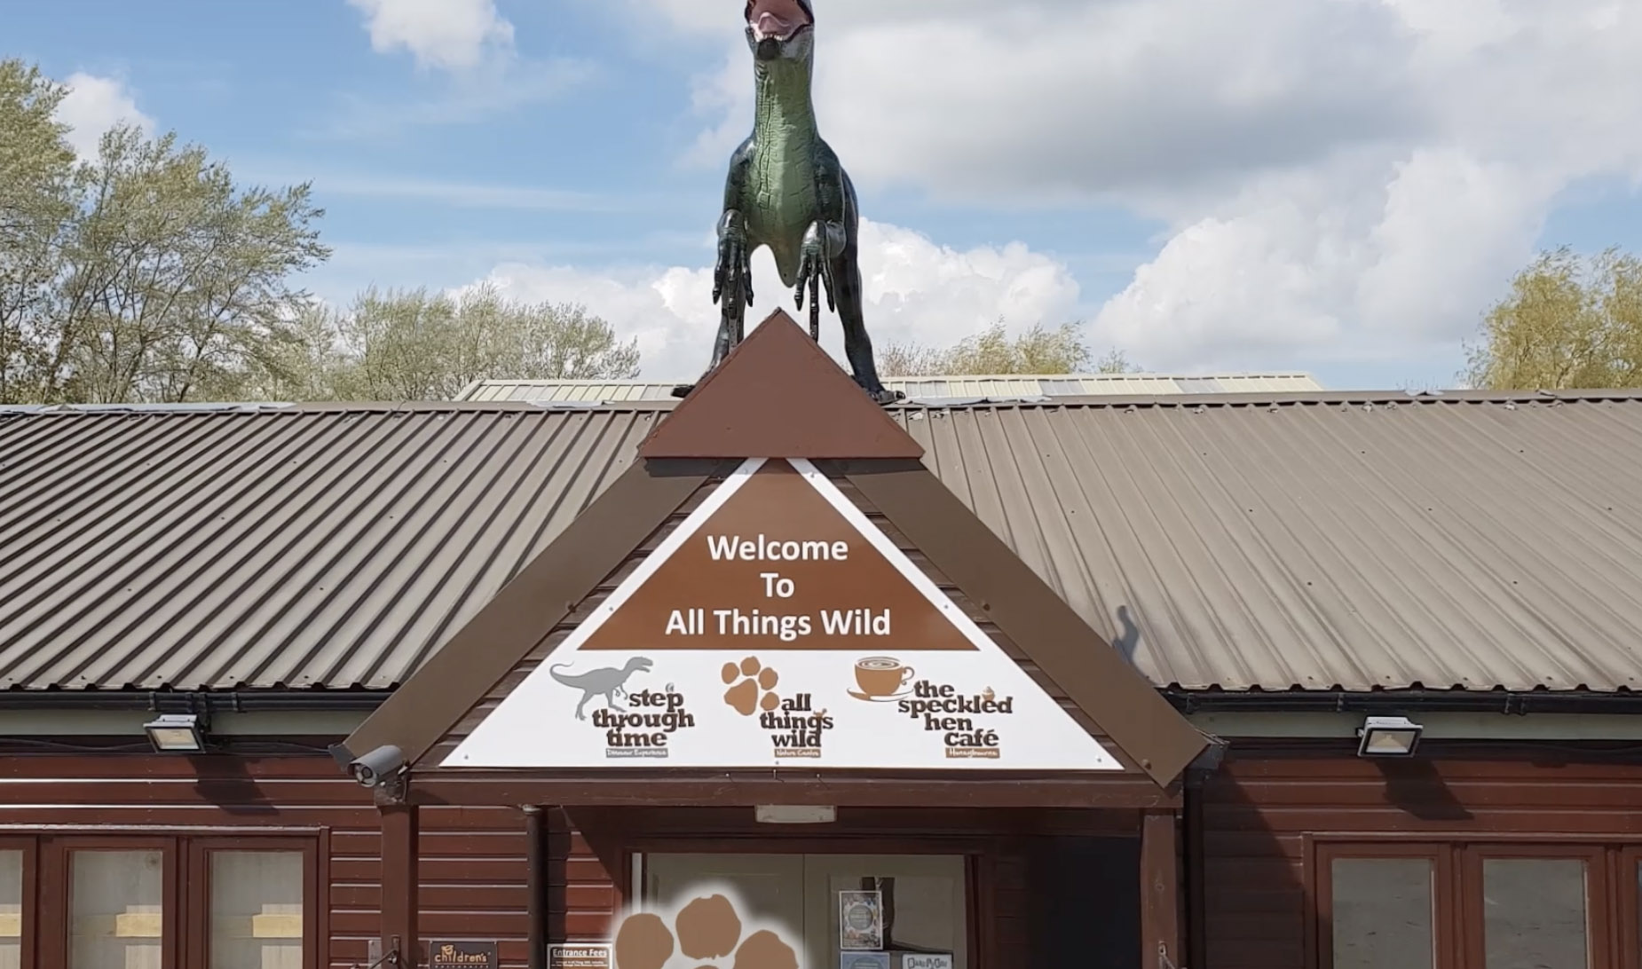
Yr3 Experiences

Slide 19
We look forward to working with you together in partnership.

