Slide 1

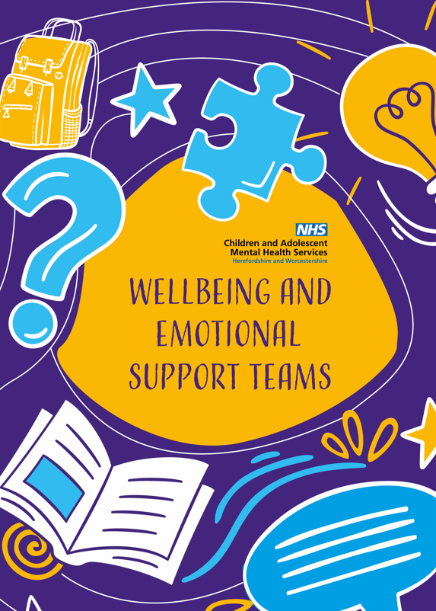

WEST
Wellbeing and Emotional Support Team

Slide 2

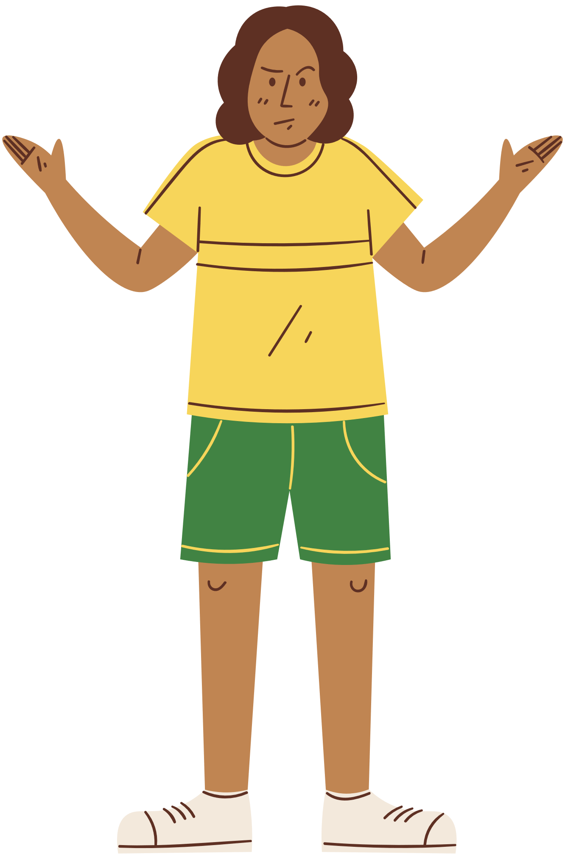

What is WEST?
OUR MISSION
To “An early intervention service, integrated in education settings to promote children’s and young people’s emotional wellbeing, keeping the child’s voice at the heart”
ToWe are a free, year-round service for young people aged 5-18 years.

Slide 3




The 2017 government green paper: Transforming Children and Young People’s Mental Health Provision
Why do MHSTs exist and how can they help?
To prevent children developing mental health problems or identify and support problems earlier
To reduce waiting times for mental health support
To support schools showcase activity for Ofsted

Slide 4




What are the core functions of MHSTs?
To provide direct support to children and young people with MILD to MODERATE mental health issues;
Support educational settings to introduce or develop their whole school approach to mental health and wellbeing.
Give advice to staff in educational settings and liaising with external specialist services to help children and young people to get the right support and stay in education.

Slide 5
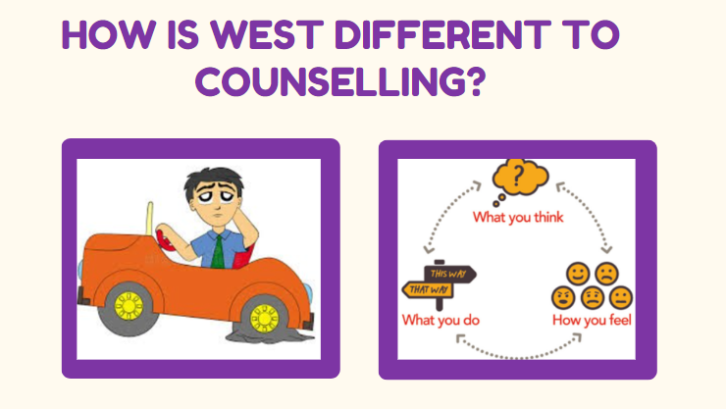

Slide 6
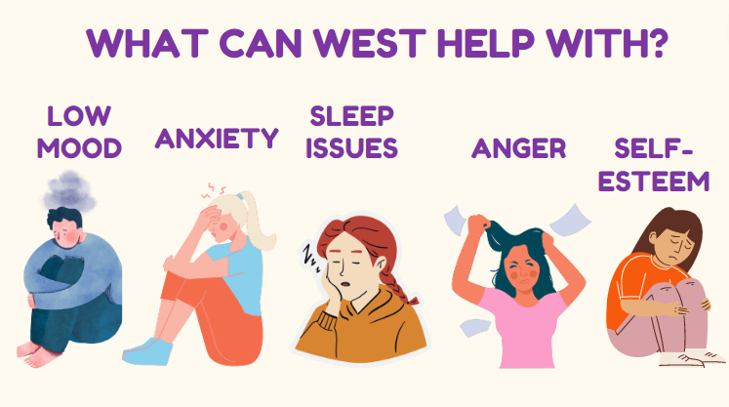
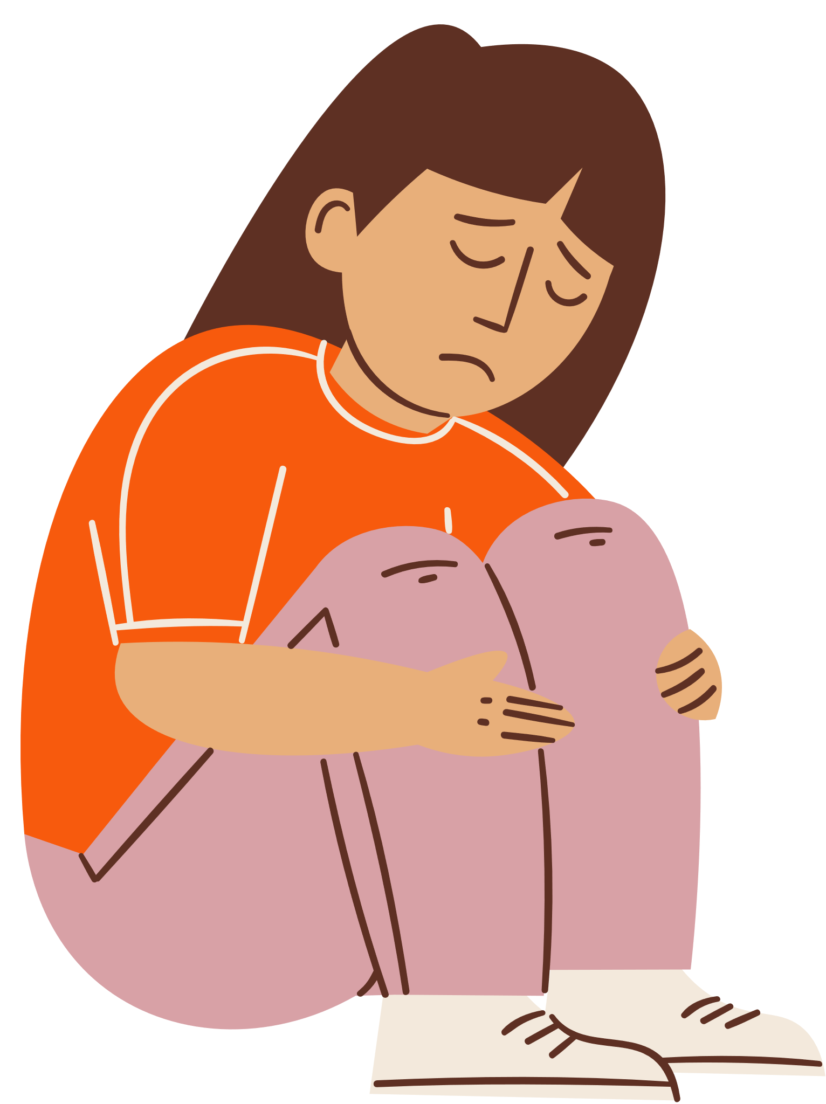
Early Intervention
For those students who might be under the radar and would benefit from 6-8 sessions of CBT support before things escalate.
Guided Self-Help
We deliver evidence-based, low-intensity, guided self-help interventions with children and young people and their parents/carers, either remotely or in a school setting. Unlike counselling we focus on practical strategies that requires commitment to undertake wellbeing tasks between sessions.
Common Mental Health Problems
The interventions we use are to support children, young people, and their families to overcome common mental health problems such as anxiety, low mood, sleep and behavioural difficulties.

Slide 7






1:1 and Group Work
Behavioural Activation
Graded Exposure
Worry Management
A treatment where young people are encouraged to increase activity levels in line with their values, to help lift their mood.
Used to tackle the avoidance of feared and anxiety-provoking situations, by gradual exposure to them.
Worries are classified into different types so that they can be dealt with effectively
Cognitive Restructuring
Sleep Hygiene
Parent-led CBT
Basic guidance and routine-setting around healthy sleep habits.
Techniques to treat anxiety with parents of children up until the age of 12.
An intervention that helps people notice and challenge their unhelpful thinking patterns.

Slide 8
What Can MHSTs Work With?

Slide 9





The Whole School Approach
A whole school approach to mental health involves everyone being committed and working in partnership to improve mental health and wellbeing across the school. This includes senior leadership, all school staff, parents and carers, and members of the wider community.
Curriculum, Teaching & Learning
Enabling Student Voice
Targeted Support
Workshops
Leadership & Management
Identifying Need & Monitoring Impact
Working With Parents /Carers
Ethos & Environment
Staff Development
Workshops

Slide 10


Raise any concerns
with Mrs Bury, Mrs Eaborn or class teacher
Designated person to complete WEST referral form
Parents consent to be sought
How do I refer?
Referral sent to MHST
to be considered or signposted on

Slide 11
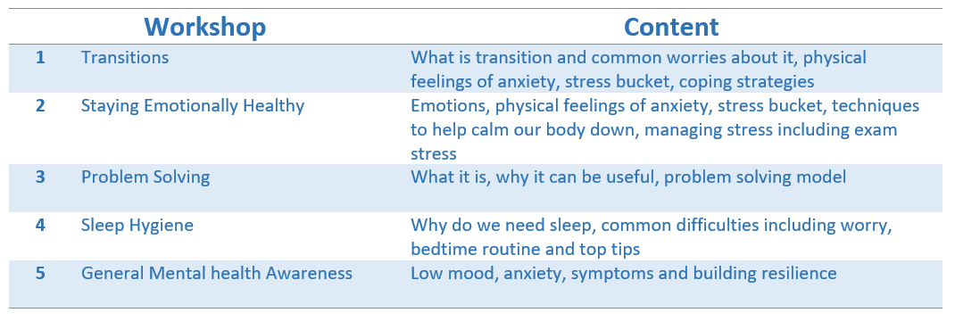

Sessions for Parents
One session can be delivered per term. Each session lasts up to 1 hour.

Slide 12
WEST
Survey

Slide 13



Thank you!
Do you have any questions?
camhs.hacw.nhs.uk/west

