Slide 1
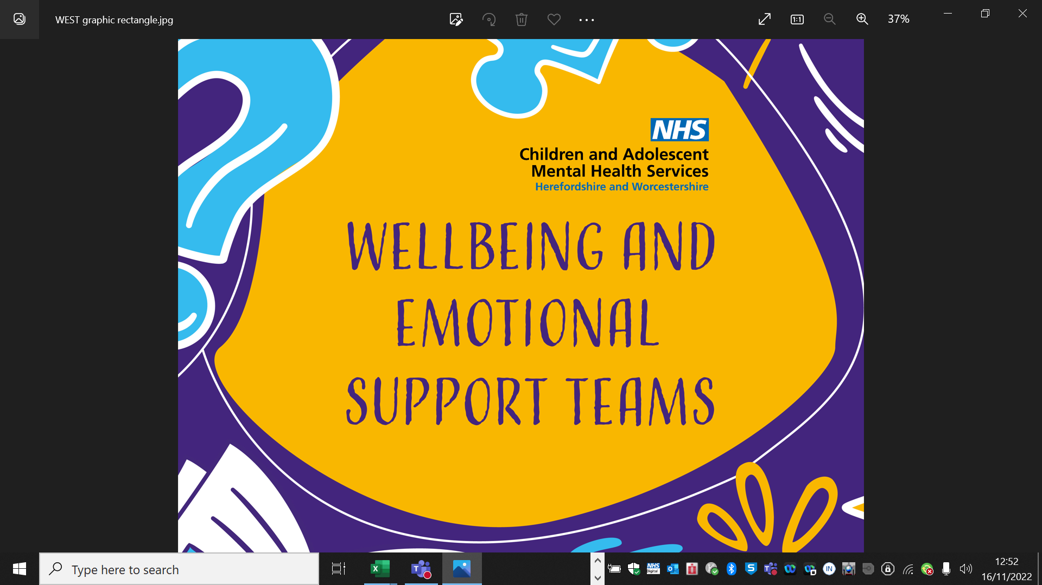
Looking after your Wellbeing

Slide 2
Agenda
Ice Breaker
What is wellbeing , what it means to you and what can affect it?
5 ways to Wellbeing & how to look after your Wellbeing
Problem solving case study
Sleep Hygiene
Where to ask for help

Slide 3
Self Care – back to basics
Notes:
ACTIVITY – Self care – back to basics:
Ask the following questions to the group, asking them to lift a finger if they answer ‘yes’ to these basic questions:
You may ask them to close their eyes if they want to focus on task?
(pick and choose as many as you want to use)
Have you eaten today? In the last 3 hours?
Have you had a drink of water today?
Have you been outside today?
Have you stretched or moved your body today?
Have you taken a moment to take a BIG deep breath?
Did you sleep last night? More than 7 hours?
Have you showered, washed your face or brushed your teeth in the last 24 hours?
Have you reached out (spent time with/talked to) to your friends or family today?
Have you done anything today that you enjoy?
Have you done your hair today / make up and are you wearing clothes you like?
Have you listened to some good music recently or read a book that you enjoy?

Slide 4
What is wellbeing mean to you?
Notes:
5 MINS
Groups – flip chat discussion – How would you define wellbeing – what does wellbeing mean to you?
OR Ask the class to shout out, write down, then feedback to group

Slide 5
What is wellbeing?
Our wellbeing is made up of many things, but when we have a strong physical and emotional wellbeing we feel that we can cope well and respond to life positively…
Feel happier
Have better relationships with others
Do better in school
Solve problems well
Cope better when things get tough
Less likely to have mental health problems
Notes:
The Oxford dictionary states that wellbeing is a state of being comfortable, healthy, or happy’…
Our wellbeing is made up of many components, but when we have a strong physical and emotional wellbeing we feel that we can cope well and respond to life positively…
Feel happier
Have better relationships with others
Do better in school
Solve problems well
Cope better when things get tough
Less likely to have mental health problems

Slide 6
What can affect my wellbeing?
Notes:
Ask group question – “What affects your wellbeing?”
Suggested group Activity: Write on white board in front of class ideas – children to shout out ideas.
What affects your wellbeing may not be the same for somebody else. But some common things that affect wellbeing are:
Being tired, falling out with friends, parents separating, too many things to do and not enough time to relax
Losing somebody or something we love such as a loved one or a pet.
You may experience difficulties in one or more of these areas, or even experience problems not listed here. That's okay. Everyone is different.

Slide 7
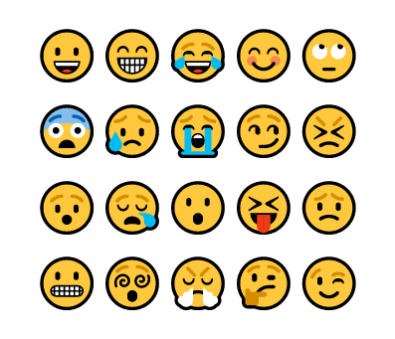
Naming Emotions
Notes:
What emotions can you name? Put hands up, what do you look like when you feel this?

Slide 8
What happens when we don’t look after our wellbeing?
Notes:
Good wellbeing doesn't mean you'll always be happy. It's normal to feel sad, angry, or low sometimes.
But if you have poor wellbeing for a long time, you might start to find things such as sleep, your appetite, friendships, school work and trying new things more difficult to cope with.

Slide 9
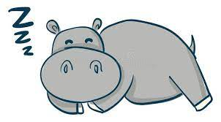
Sleep Hygiene
Every creature needs to sleep – dogs, cats, giraffes and hippopotamuses all get some shut eye.
Sleep gives our body a rest and allows us to prepare our energy for the next day.
Humans need at least 8 hours of sleep per night
Children and young people need sleep to help regulate their
emotions and bodily functions
Notes:
All the areas we have talked about today need one very important thing – SLEEP.
Sleep is not only essential for rest so that we have energy, but it also enables the brain to sort through and store information releasing chemicals into our bodies that enables us to manage our emotions, think clearly and problem solve
Humans need at least 8 hours of sleep a night!
This is especially important for children/ young people as their brains are developing and are managing complex thoughts and feelings everyday whilst coping with different situations that might affect how they feel and behave.

Slide 10
Notes:
SLEEP HYGIENE
'Sleep hygiene' refers to healthy habits, behaviours and environmental factors that can be adjusted to help you have a good night's sleep
Go through the slides for examples, invite group to feedback for any tips they have for getting a food nights sleep?

Slide 11
Five Ways to Wellbeing
Notes:
Evidence suggests that there are 5 steps you can take to improve your emotional health and wellbeing.
We can all probably recognise times when we feel down and stressed. Sometimes there is a clear reason why we are feeling this and with time these feelings pass. Occasionally these feelings may continue, to prevent this we can take steps to make sure we feel emotionally well.
When we connect with others it gives us emotional support.
Being Active not only boosts our physical health and fitness, it also changes chemicals in our brains which have a positive effects on our mood.
When we take notice it helps us to enjoy the little things in life that we often take for granted. It can also help is to feel grounded and calmer and stop us from getting caught up in our thoughts.
When we learn new things it boosts our self esteem and gives us a sense of satisfaction.
When we give, even if its just giving somebody a smile or a small act of kindness like opening a door and letting someone through first, it helps us feel happier and more satisfied with life.

Slide 12
The Gratitude Game
Notes:
10 Second Gratitude Challenge https://youtu.be/0lRQkSPzJWk This two-minute video, featuring our Bow-Wowza dogs, introduces the idea of gratitude and thankfulness to pupils, whilst also explaining why gratitude is good for the brain and how it makes us feel good.
What does gratitude mean? (thankfulness) • Do you remember what the dogs were grateful/thankful for? • What sorts of things are you grateful/thankful for? (Including big, constant things like family, nature etc, but also small daily things like a yummy lunch, someone being kind etc.)? • How can we show others our gratitude? How can we show that we are thankful for something
Ask pupils to write down as many things they can think of that they are grateful for in the worksheet.

Slide 13
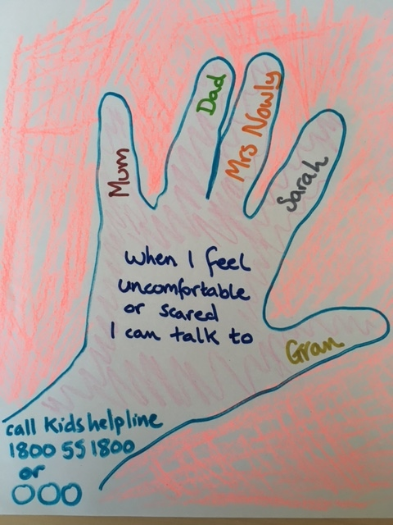
Ask for help if you need it
Who in school can you ask for help?
Who at home can you ask for help?
Notes:
Ask Children to give ideas of who they can talk to if they need to

Slide 14
What can you remember?
Name one of the Five Ways to Wellbeing?
Connect, Be Active, Give, Keep Learning, Notice
Name one thing that helps you to get a good night’s sleep?
Daytime exercise, coming off screens an hour before bed, avoiding naps
Name one thing that you are going to differently to help your Well-being? Get a good night sleep, talk to friends, go on a walk, play on your bike

Slide 15
We’ll learn how to make a coping skills fortune teller.
Notes:
Watch video on how to make a fortune teller before workshop- https://youtu.be/CODnVX7VAZ8
During workshop take children through the process step by step

Slide 16
Thank you and Good luck
We hope this has been interesting and useful.
If you feel you would benefit from a referral to the WEST team to support you with your mental health and wellbeing, please speak to your parent/carer and/or school about a referral to us.
Notes:
FINAL SLIDE FOR CYP WORKSHOP
Please ask the group to complete the evaluation form, it’s just 2 questions. This helps us to evaluate the service we provide and hopefully demonstrate it’s effectiveness.
If anyone feels that they could benefit from support from WEST to help them address their menta wellbeing, they can speak to their parent/carer and/or school staff about whether a referral to us would be useful. Schools don’t always recognise difficulties for yp at school so they may need you to share with them any concerns.

