Slide 1
Geography at St Joseph’s

Slide 2
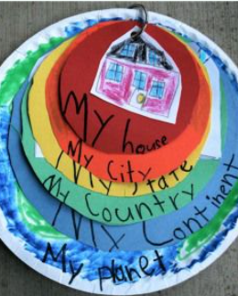
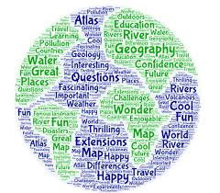
When I leave St Joseph’s…
I am going to be a GEOGRAPHER.
What will this look like?

Slide 3
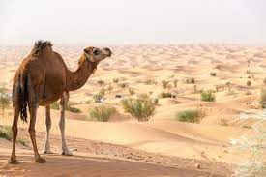
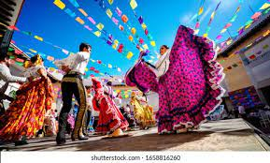
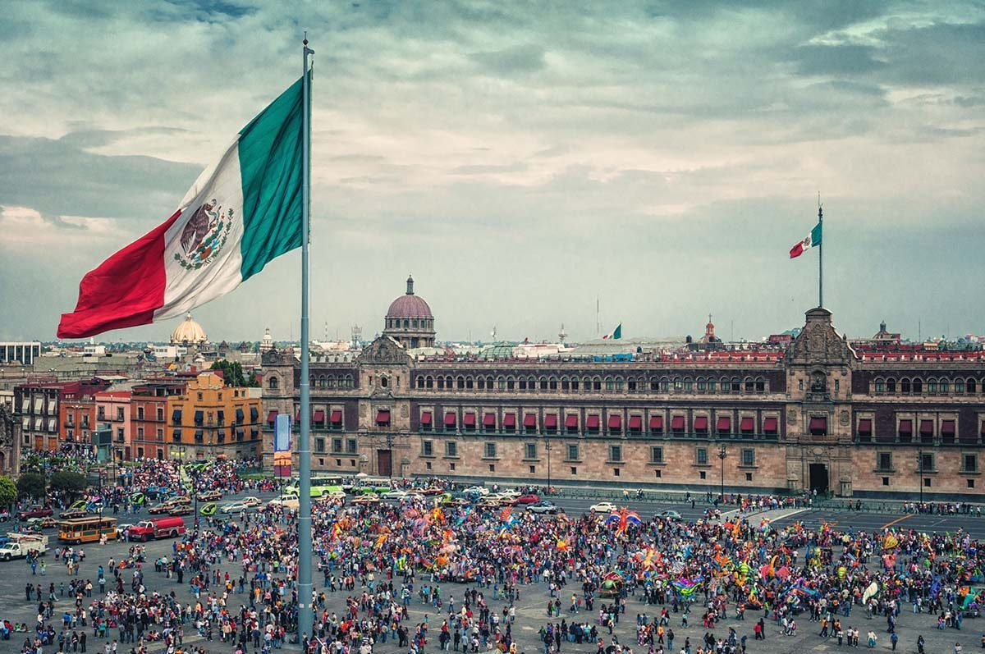
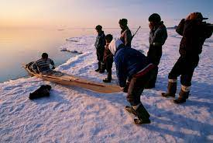
I will be able to…
understand different places in the world and what they are like.

Slide 4
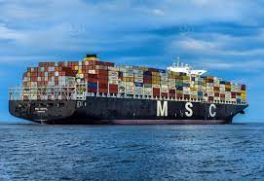
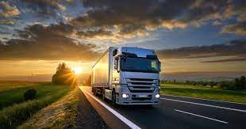
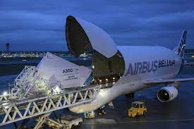
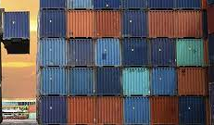
I will be able to…
know how different places are and how they are connected by trade links.

Slide 5
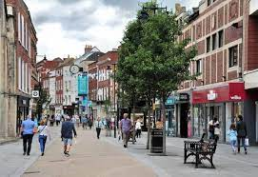
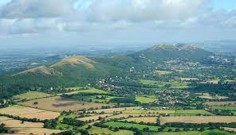
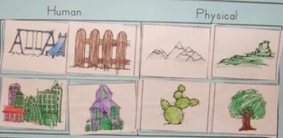
I will know…
what the human and physical environments are like and how these are different around the world.

Slide 6
I will be able to…
use geographical vocabulary to understand what is going on in the world.

Slide 7
I will be able to…
ask questions and analyse different parts of the world.

Slide 8
I will be able to…
reach conclusions through researching and exploring

Slide 9
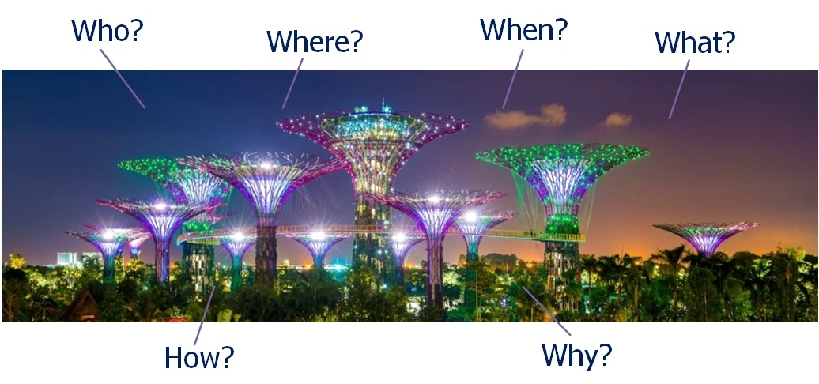
I will be …
original in my presentation of work to represent my findings.

Slide 10
I will have…
had lots of fieldwork opportunities that will help me to analyse the world around me.

Slide 11
I will grow…
a curiosity of the world and be excited about finding out about different cultures and how people live.

Slide 12
I will be able to…
give well-balanced opinions from my good knowledge of society and the environment.

