Slide 1
Advent
Preparing for Christmas

Slide 2
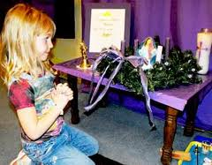
Purple
The colour purple means we are preparing for something.
Can anyone think what we are preparing for?

Slide 3
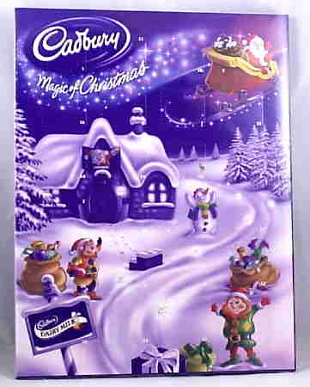
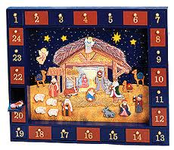
Advent Calendars

Slide 4
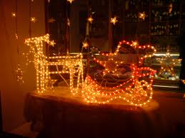
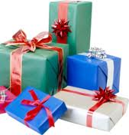
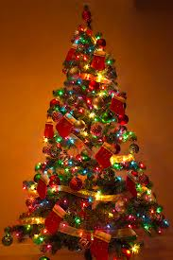
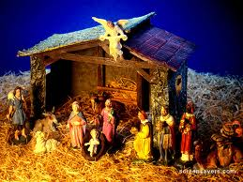
Getting Ready…

Slide 5
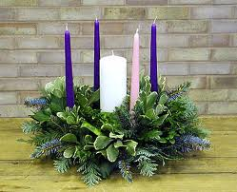
Advent wreath
Purple – Hope
Purple - Love
Pink – Joy
Purple - Peace
White – Jesus Christ
The wreath is green and a circle shape to symbolise eternity (continuing for ever)

